Slide 1



Sensor Biocompatibility
By: Shantel Shaver
Mentor: Jeffery La Belle
School of Biological Health and Systems Engineering

Slide 2

The Problem
Continuous Stress Assessment
TBI, food deprivation, strenuous exercise and diabetic or pre-diabetic tendencies.
“A TBI is caused by a bump, blow or jolt to the head or a penetrating head injury that disrupts the normal function of the brain.”(CDC,Center for Disease Control)

Slide 3
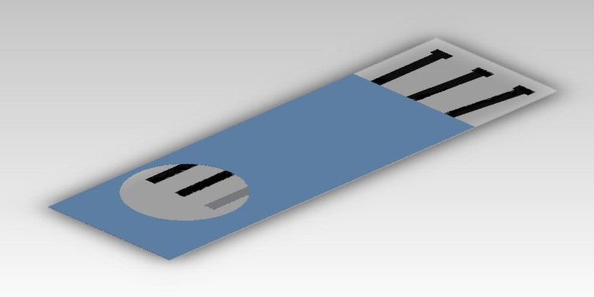
Solution
My team is working to create a continuous glucose lactate sensor to monitor the fluctuating biomarkers of stress.
Currently I am exploring materials to be used in a continuous subcutaneous sensor device to detect these glucose and lactate levels and potentially additional TBI biomarkers.
Notes:
Future work will include running electrochemical tests for blood lysis using a mixture of screen printed materials currently used in the diabetes test strip industry.

Slide 4
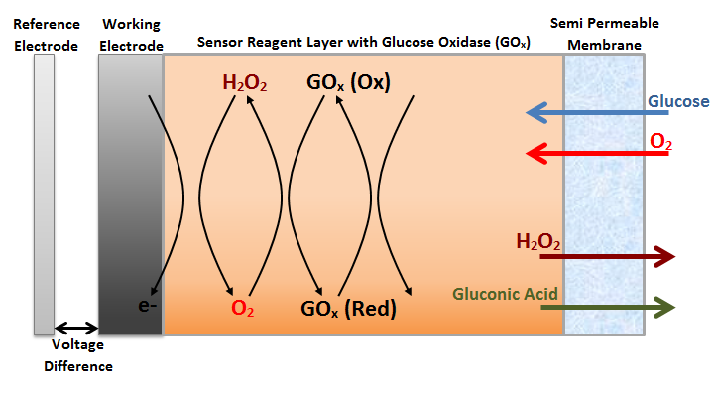

Principle of Device
The proposed method of sensing the glucose biomarker for stress related applications is based on the Clark amperometric sensor design which operates based on the following equations:
$\left(1\right) Glucose+{GO}_{x}\left(FAD\right)→Glucolactone+{GO}_{x}(FADH_{2})$
$\left(2\right) {GO}_{x}\left(FADH_{2}\right)+O_{2}→{GO}_{x}\left(FAD\right)+H_{2}O_{2}$
where FAD is flavin adenine dinucleotide and GO_{x} is glucose oxidase. The generated H₂O₂ is amperometrically assessed on the surface of working electrode by the application of the appropriate redox potential, hence relating the current to glucose concentration as shown in the following equation.
$H_{2}O_{2}\underset{→}{+v}O_{2}+2e^{−}+2H^{+}$
Figure (1)The first image is a sisual representation of electrochemical processes occurring within proposed sensor design.

Slide 5
Objective and Process
Decide/develop a minimally invasive device for the purpose of sensing glucose, lactate, and potentially other biomarkers.
Test physiological compatibility of materials and components.
Process-
Develop and compare several device designs to optimize function and physiological compatibility.
Test materials and components
Build first prototype
Materials
Sensor material
Pig skin
Adhesives
Wire, hooks, weights
General lab equipment
iworx/labscribe
Plastic apparatus

Slide 6
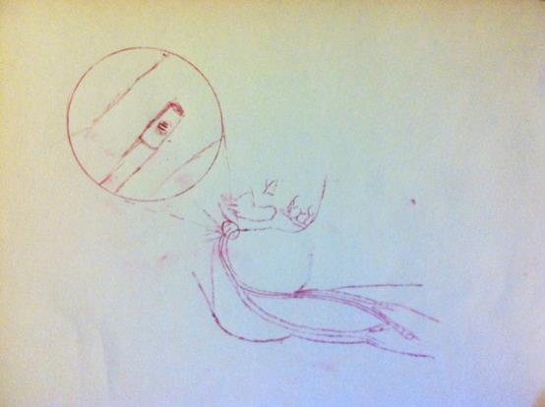
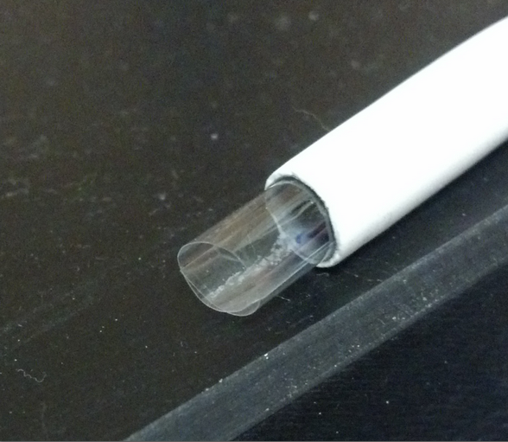
Design
Customer needs
Speed
Accuracy
Physiologically compatible
Affordable
Design specifications
Concept generation
Concept review
Concept testing

Slide 7
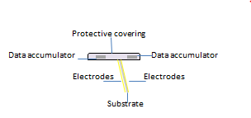
Methods (Pressure)
Subcutaneous
2 electrodes
Simple to use
Sturdy base
Figure: the image is a geometric layout of the final device.
Notes:
Ref http://www.ncbi.nlm.nih.gov/pubmed/8491446
Average blood flow is 40 plus or minus 3 in the brachial artery and (if we use something else it is probably over engineered)

Slide 8
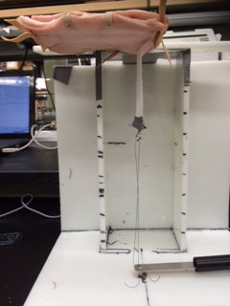
Testing components (adhesives)
Based on the ASTM standard for testing adhesives at a 90 degree angle, I created an apparatus that would allow me to measure the force applied over time until it was removed by the weight.
Material for skin would be pigskin which has many similar properties to human skin.
So first I will try it dry and then do the same thing after soaking it in water for a day(bath).
Notes:
I am not quite sure what to put for pressure anymore because the data no longer looks like this? Also control is not like this at all…

Slide 9
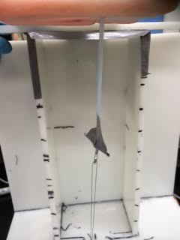
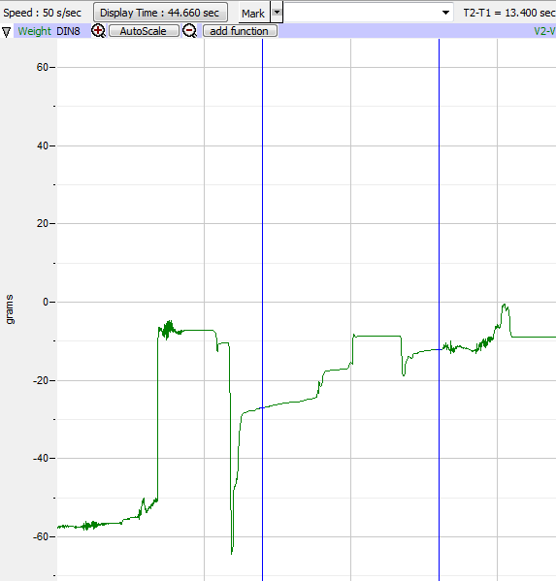
Apparatus and raw data

Slide 10
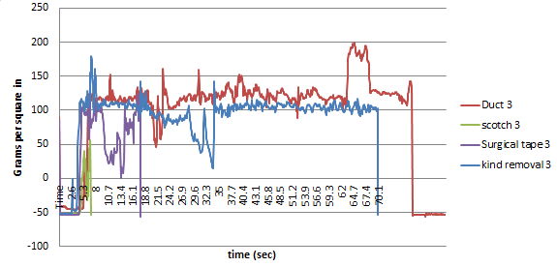
Compared Curves
Notes:
The purpose of hemolysis testing is to observe how much of the blood was lysing and lysed as it flowed through the graft multiple times. This was accomplished with absorbance spectroscope. The ratio between the peaks of the run and un run blood samples will show whether or not there was negligible amounts of hemolysis.
The blood concentrations needs to be at least twenty five percent to achieve realistic blood behavior, which is why a twenty-five percent concentration of blood was run through the apparatus with PBS as the buffer.
Samples were taken before and after the run and further diluted to allow for absorbance to take place.
The samples were then run through the absorbance spectroscopy and the peaks were measured.

Slide 11
Resulting data
 | tape type
weight 76.2g | kind removal | surgical | duct tape | scotch
sec | 63.1 | 12.9 | 71.6 | 1.8
 | tape type
20g/every 10sec | kind removal | surgical | duct tape | scotch
Grams | 97.8 | 40 | 56.7 | 13.6

Slide 12
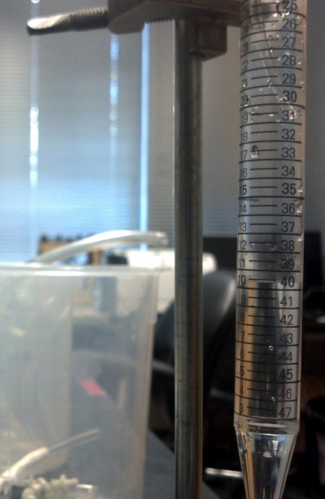
Where the project is at
Decided on a device design that will be minimally invasive for the patient, and still deliver accurate results.
Continuing to test electrochemical sensing process for the purpose of apparatus integration.
Materials have been confirmed for substrate.
Positive adhesive data.
Notes:
Mylar is less expensive while copper is a better conductor.

Slide 13

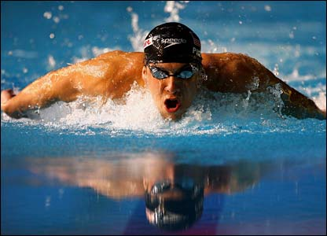

Future work
Immediate: create a solidworks model that can be used to test the adhesive under movement. And under porous conditions.
Solidworks model
Attach to tape and test durability
Design Seat simulating apparatus to test under moist conditions.
Combine with Sense testing under movement

Slide 14
Acknowledgements
Many thanks to the NASA Space Grant for making this all possible, to the entire La Belle Group Lab, to my parents for always supporting my academic interest. A special thanks to John my capstone partner and Brittney Haselwood for her support and assistance. And to my mentor, Dr. La Belle, for the opportunity and resources to design and explore new possibilities.

Slide 15

Questions?

